Slide 1
Machine learning for Banking and Financial Systems (Day1 – Introduction to machine learning and R)
Dr. Siva
(AVM-Cognizant Technology Solutions)

Slide 2
Data science, also known as data-driven science, is an interdisciplinary field about scientific methods, processes, and systems to extract knowledge or insights from data in various forms, either structured or unstructured, similar to data mining.
Data mining is a process using which sensible information from large amount of both structured and unstructured data can be extracted.
Data analytics refers to qualitative and quantitative techniques and processes used to enhance productivity and business gain. Data is extracted and categorized to identify and analyze behavioral data and patterns, and techniques vary according to organizational requirements.
Machine learning refers to construction and study of algorithms that can learn from data.(Wiki).
Data science, Data mining and Machine learning,….

Slide 3
Machine learning
M1 | Intro+R
M2 | Maths 1 | Basic Stats - Mean, Variance, SD, Exploratory Analysis and Plots, Covariance, Correlation, Probability
M3 | Maths 2 | Advanced Stats - Distributions, Sampling, Hypothesis Testing, Goodness Metrics. Statistical tests such as chi square, t test, ANOVA
M4 | Maths 3 | Vectors, Matrices, Cosine Angle, Derivative, Maxima, Minima, Gradient Descent
M5 | Regression | Linear, Logistic and other variants (SVM and NN); Regression assumptions
M6 | Decision Trees | CART, Boot strapping and bagging, random forests, Boosting
M7 | Clustering+… | Clustering, Correlation and PCA. Time series
M8 | Model building and evaluation 1 | Outlier and missing value treatment, binning, normalization, variable transformation
M9 | Model building and evaluation 2 | Model evaluation and performance analysis (ROC, F measures, )
M10 | Text Mining | DTM, TF-IDF, Topic Modeling, Sentiment Analysis
O1 | Misc - Time series and Markov models
O2 | PCA | Eigen Values, Eigen Vectors

Slide 4
Data science, Data mining and Machine learning,….
Business case studies
Big data, Distributed processing technologies
Technologies for Machine learning
(Azure, Amazon etc.,)
(Hadoop, Hive )
Back ground mathematics
Implementation with R
Statistical Machine Learning
Theory of data mgmt.
Examples

Slide 5
Unique challenge in Analytics
In software industry, the user requirements are deterministic and expected results are totally prefixed.
However, in analytics, the expected results can’t be clearly pre specified.
Hence, it is necessary to know the theory behind our tools.

Slide 6
Database and intelligence
Database applications flourished from 1960s with main frame.
Essentially nice reports are generated suited to the requirements.
Example:
“Select * from <table> where class = 8 and subject = “Maths” and marks = 100;”
Name | Class | Subject | Marks | Teacher
Ram | 8 | Maths | 100 | Kumar
Siva | 9 | Maths | 100 | Kumar
Ram | 8 | English | 98 | Ashok
Name | Class | Subject | Marks | Teacher
Ram | 8 | Maths | 100 | Kumar
Siva | 9 | Maths | 100 | Kumar
Ram | 8 | English | 98 | Ashok
Many types of questions can be answered
Percentage of students scored 100% in Maths in the school
Percentage of students who are above 90% average marks.
Further analysis can get us some more useful insights.
List the ‘Teacher’ in the order of percentage of passed students in a given subject and class.
List the teachers in the order of top marks in each subject and class.
These type of queries can help in some amount of decision making.

Slide 7
Statistics
The development of statistics would give rise to some more data elements which ‘d give more useful information.
Example: Average and variance
As per probability theory, the average of the past values is the best prediction for future. (Loosely speaking)
Variance is the measure of dispersion.
Ultimately, these properties of the data elements were useful to the users especially the decision makers to some extent.
Example1:
Some teachers will take care of the entire class, may not give special attention to the bright, - in this case, variance will be small.
Some may focus at bright students, there will be many toppers but many will be left at the bottom.
Example2: The combination of mean and variance in portfolio optimization won the Nobel prize.

Slide 8
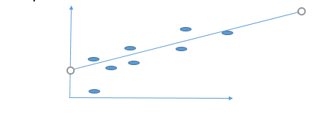
Regression (Forecasting)
The next stage was to get idea about pairs of data. (combined behavior)
There came the branch of mathematics ‘curve fitting’.
The seeds for the field ‘machine learning’ started from there.
One element was mostly ‘time’.
Example (transition to machine learning):
Given single set of observations x1,x2,x3,x4 we can find the average as
Xbar = Σ xi/N; Variance = ( Σ (xi – xbar)**2 ) /N;
Standard deviation = Sqrt(Variance).
We can also find the variance and standard
deviations with the commands available in
the database languages.

Slide 9
Example: St. line fitting
Time | Temperature
1 | 50
2 | 52
3 | 54
4 | 56
5 | 58
Suppose the observations are (x1,y1), (x2,y2) …..
Suppose x refers to time axis. Y is the temperature.
We are given temperatures as 50,52,54,56,58.
Simple statistical average gives the average temperature as 270/5 = 54.
Question:
What could be the temperature at t= 6?
Is it the average of all the readings 54 (or)
60?. (50+(t-1)*2)
The ‘average’ rule is applicable when the data elements satisfy certain properties such as it oscillates between a constant number.
For other situations, better models are to be constructed. There, evolved the field machine learning.

Slide 10
Summary
i) The database tables and associated queries can only give the subset of available data records as answers. (may be with statistical estimates.)
ii)Statistics is a slight improvement.
iii)Machine learning is the one that generalizes the data by extracting essential information(model) suitable to generalization.
In this case, a straight line curve fitting resulted in the expression
temperature = 50 + 2*(t-1) = 48+2t
Ideally the form ax + by = c in x,y space.

Slide 11
Data with noise
This process could be extendable to the data with minor variations in the data with help of mathematical techniques called ‘Optimization’.
The solution is arrived at by choosing a and b
such that
(temperature – (a (time) + b)) is made
minimum by the choice of ‘a’ and ‘b’.
To avoid cancellation of positive and negative terms,
choose ‘a’ and ‘b’ such that
(temperature – (a (time) + b))² is minimum.
The field is known as ‘optimization’.
This could be extended to multiple observations case.
Time | Temperature
1 | 50.5
2 | 52.8
3 | 53.8
4 | 55.7
5 | 57.3

Slide 12
Complex modeling
In the previous case, we had a simple model
y = mx + c or ax + by + c = 0 in x, y plane.
In practice,
there could be thousands are factors (dimensions, attributes, features, etc., - all are known as exogenous variables).
the relationship we assumed could be more complex.
may be a polynomial, straight line with sinusoidal etc(trend with seasonality).
Machine learning addresses these issues and help us to arrive at ‘optimal model’.
At the same time, there is no ‘universal model’ or algorithm which could generate model for any type of data. This fact is known as ‘No free lunch theorem’.

Slide 13
Evolution of machine learning – from AI, Stats, control and ofcourse Mathematics
Computer scientists tried to mimic the brain.
The first learning process a human undergoes is ‘classification’ hence computer scientists developed the theory of pattern recognition.
Concepts were borrowed from the way the mothers teach the infants.
This resulted in linear regression which turned out to be generalization of simple curve fitting mentioned before.

Slide 14
Difference between Machine learning and statistical modeling
Machine Learning is …
a subfield of computer science and artificial intelligence which deals with building systems that can learn from data, instead of explicitly programmed instructions.
Statistical Modelling is …
a subfield of mathematics which deals with finding relationship between variables to predict an outcome

Slide 15
Evolution of data collection, storage and maintenance
The relational databases is a major steps..
The data ware house concepts got developed in 80s.
Developments in mobile technology, wireless communications, sensor technology – all gave rise to availability of enormous amount of data at cheaper costs – the marketing teams naturally looked for applications.
Distributed data storage like Hadoop made distributed database technology accessible to all.
Unstructured databases such as Cassandra enabled handling of different types of data.
Cloud technology enabled the developments accessible to all types of users.

Slide 16
Overview of
Machine Learning algorithms

Slide 17
Email spam identification (http://ats.cs.ut.ee/u/kt/hw/spam/spam.pdf)
Identification of spam email is difficult task. There are two ways to handle it.
Method 1: Rule base
Based on experience, the experts develop rules to filter them off.
An example: A mail with subject containing the word(s) “BUY NOW” is certainly a spam.
Problems with rule base:
Constantly to be updated.
The spammers would also learn from experience!!!!
Method 2: Machine learning
A set of pre-classified documents (training samples) is needed.
A specific algorithm is then used to “learn” the classification rules from this data.

Slide 18
Machine learning in Spam detection
Suppose we have a large number of samples classified as either spam or genuine.
Email content | Spam or not
Win the prize $10000. Unbelievable!!! | Y
Ram won the prize in music competition. | N
Free Himalayan tour! Ne’er in lifetime!!! | Y

Slide 19
step1
Extract some specific features from the sample data in the form of numbers (feature vector).
Most of the time the vector that indicate the presence of the words or something similar is used.
Here the reference list is
Words = ( “WIN”, “PRIZE”, “FREE”)
Spam email1: x1 “Win the prize $10000. Unbelievable”
Data Vector x1 = (1,1,0);
Output = 1
Non spam email2 : Ram won the prize in music competition.
Data vector = (0,1,0) ; Output = -1;
Spam mail 3:” Free Himalayan tour! Ne’er in lifetime!!!
data vector = ( 0,0,1); Output = 1;
This data set is just for demo purpose. May not reflect the true situation.

Slide 20
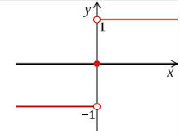
Learning from examples
Step 2: Training
w1, w2,w3, … be the weights for each data element. W(=(w1,w2,w3)) and b are the parameters to be determined. ‘c_{i} ’ denotes whether the email ‘i’ is a spam or not. c_{i} = 1 if it is spam and -1 if it is not.
Algorithm:
Initialize w and b (to random values or to 0).
Find a training example (x_{i}, c_{i} ) for which
sign(w^{T} x_{i} + b) != c_{i} .
Sign(.023) = 1; sign(-.223)=-1
If there is no such example, training is completed. Store the final w and b and stop. Otherwise go to next step.

Slide 21
Fundamental approach for solutions to the problems (Improved guess := original guess + step size * error
Training
w1, w2,w3, … be the weights for each data element. W(=(w1,w2,w3)) and b are the parameters to be determined. ‘c_{i} ’ denotes whether the email ‘i’ is a spam or not. c_{i} = 1 if it is spam and -1 if it is not.
Algorithm:
Initialize w and b (to random values or to 0).
Find a training example (x_{i}, c_{i} ) for which
sign(w^{T} x_{i} + b) != c_{i} .
Sign(.023) = 1; sign(-.223)=-1
If there is no such example, training is completed. Store the final w and b and stop. Otherwise go to next step.

Slide 22
Algorithm…
3) Update (w, b):
w(new) := w + c_{i} * x_{i}, b := b + c_{i} after ‘i’th sample is received.
w1(new) = w1 + c_{i} * x1_{i};
w2(new) = w2 + c_{i} * x2_{i};…….
Go to previous step.
(This algorithm is arrived at by minimizing the objective function
Σ (w^{T} x + b)
for a set of x which misclassified. Here ‘x’ itself is the ‘gradient’. Details would be dealt later.
Classification
1. Given a message x, determine its class as sign(w^{T} x + b)
Basic idea behind the algorithm:
Improved guess := original guess + step size * Gradient direction of the error.

Slide 23
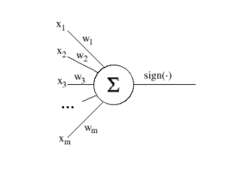
Perceptron and neural network
The above algorithm gave rise to ‘Neural networks’.
This process is called ‘Perceptron’.
This structure resembles the functioning of neurons in brain.
The neurons in the brain are triggered by incoming nerves when the total sum of the electric potentials reach some threshold called ‘firing potential’.
For practical purposes (which ‘d be described later) the switching function Sign() is replaced by a function called sigmoidal function.
If the vectors to be classified have only two components (i.e. x ∈ R 2 ), they can be represented as points on a plane. The decision function of a perceptron can then be represented as a line that divides the plane in two parts. Vectors in one half-plane will be classified as belonging to one class, vectors in the other half-plane—as belonging to the other class.
Dropping the subscripts, we can write these as
w1 x1 + w2 x2 +b <> 0. This means that if we find a line in 2 dim plane based on the above expression that line divides the plane in to two halves.
One half represents Spam and the other normal.

Slide 24
Support vector
The equation represents the ‘classification’ governing equation.
It could be seen to divide the plane into two parts.
Now, there are plenty of lines which could divide such that the circles and triangles are separated.
We can choose the one such that the points are away from the ‘dividing line’ as far as possible.
This method is known as ‘support vector’ which is very popular.
w1 x1 + w2 x2 +b = 0

Slide 25
Linear regression – least squares formulation
Assume that there are only two attributes for the purpose of illustration.
The same problem can be formulated as
W * Xi + b= 1 if it is spam.
= 0 if it is not spam.
Here Xi be the i’th vector and W be the corresponding parameter vector.
The problem is to choose W such that the total error for all the samples is minimum.
Suppose there are just n sample data sets and 2 features then we will have a system of equations
w1 x1₁ + w2 x2₁ + b= 1 and
w1 x1₂ + w2 x2₂ + b= 0;
w1 x1₃ + w2 x2₃ + b =1;
.
.
w1 x1_{n} + w2 x2_{n} + b =0

Slide 26
Linear regression ….
Let n= 3;
Now there are 3 free variables w1, w2,b but number of equations is equal to number of samples..
We remember that there can’t exist a solution at all.
This means we have to do the best!
Possibly, for any given values of w1,w2 and bwe can compute the error in all the above equations and find the total.
We tweak w1, w2 and b in such a way that the error is minimum.
To our surprise, this approach gives a nice easily computable solution.

Slide 27
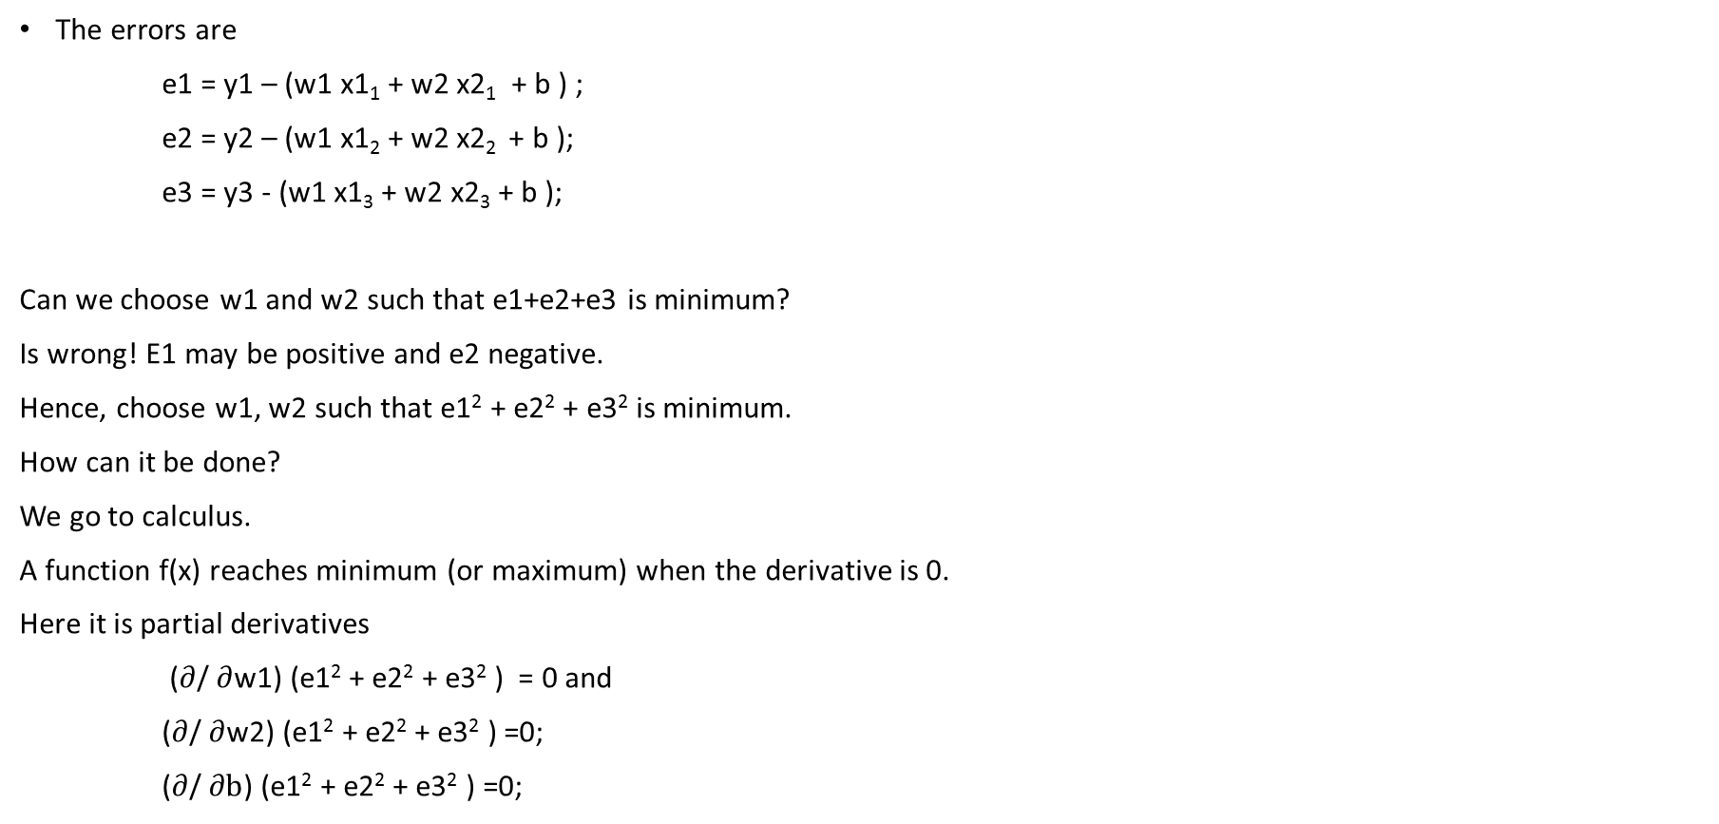
System of equations
The errors are
e1 = y1 – (w1 x1₁ + w2 x2₁ + b ) ;
e2 = y2 – (w1 x1₂ + w2 x2₂ + b );
e3 = y3 - (w1 x1₃ + w2 x2₃ + b );
Can we choose w1 and w2 such that e1+e2+e3 is minimum?
Is wrong! E1 may be positive and e2 negative.
Hence, choose w1, w2 such that e1² + e2² + e3² is minimum.
How can it be done?
We go to calculus.
A function f(x) reaches minimum (or maximum) when the derivative is 0.
Here it is partial derivatives
($∂$/ $∂$w1) (e1² + e2² + e3² ) = 0 and
($∂$/ $∂$w2) (e1² + e2² + e3² ) =0;
($∂$/ $∂b$) (e1² + e2² + e3² ) =0;
Eqn 1.1

Slide 28
Least squares
This ‘d give rise to 3 equations with 3 variables.
2( y1– (w1 x1₁ + w2 x2₁ +b ) )* x1₁ + 2( y2– (w1 x1₂ + w2 x2₂ +b ) )* x1₂ + 2 ( y3– (w1 x1₃ + w2 x2₃ +b)) *x1₃ ) = 0;
2( y1– (w1 x1₁ + w2 x2₁ +b) )* x2₁ + 2( y2– (w1 x1₂ + w2 x2₂ +b ) )* x2₂ + 2 ( y3– (w1 x1₃ + w2 x2₃+b ) )*x2₃ ) = 0;
2( y1– (w1 x1₁ + w2 x2₁ +b) ) + 2( y2– (w1 x1₂ + w2 x2₂ +b ) ) + 2 ( y3– (w1 x1₃ + w2 x2₃+b ) )
= 0;
Ultimately, in practical problems this’d give rise to lot many equations, variables etc.,
This analysis give rise to the following questions.
Is there a way to represent the system of equations Eqn1.1 in a simpler form?
Will the ‘derivative operations’ be represented in the simple representation?
The ‘matrix’ representation facilitates the above requirements.
A system of equations Eqn1.1 can be represented in the form
y -Xw where

Slide 29

Matrix representation
x1₁ | x2₁ 1
x1₂ | x2₂ 1
x1₃ | x2₃ 1
w1
w2 b
y1 y2
y3
$$=$$
X W = Y;
E = Y – X W;
|| E||²₂ = ( Y – XW)^{T} ( Y – XW );
Taking the derivative w.r.t.W we get
X^{T} (Y – XW) = 0;
X^{T} Y – X^{T} X W = 0;
W = ( X^{T} X)⁻¹ X^{T} Y;
We are led to explicit formula for the weight vector W with Matrix calculus.
The data matrix x(ij) transforms the parameters into observations. Using Eigen values theory, there is a possibility of reducing the data requirement in a systematic manner. (Principal component analysis).
This example tells us the necessity of the following mathematical machinery.
i) Matrices (Linear algebra) ii) Calculus iii) Optimization.

Slide 30
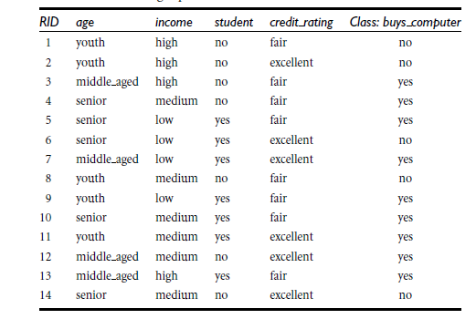
Decision tree
Motivation: When there are large number of classes, large number of attributes and most of them are discrete values, the regression approach may not perform satisfactorily and may not go well with intuition.
Many classification rules in practice are represented by rules in the form of a tree.
Question: Given some past data (features and classifications) can we derive the rule set?
Example: The diagram here gives the data on buying preferences arrived from an Electronics customer database.
The class labels: : whether a customer buys computer or not.
The data given is in the form of a table. The attributes that determine the class are age, income, student (binary) and credit rating. All are modeled as discrete values.
Expected form of the rules:
If the customer is youth, income is high and credit rating is high, he would buy computer.
If the customer is old and credit rating is fair he won’t buy the computer.

Slide 31
Basic ideas behind decision tree construction
Now, based on these attributes, customers can be split.
In a particular split, if all belong to one class, then that is desired at the top.
This means that the split which gets highest information gain be selected first.
This requires some ‘measure’ for the information content of the splits.
The information theory which had been used to compute the ‘error correcting codes’ came to the help.

Slide 32
Uncertainty and information
Measure of impurity (Information content).
Impurity – Surprising content – Information – related concepts.
How much information is contained in a split?
Consider an example of some binary event (Tossing the coin)
The probabilities (chances) of occurrence is given at sides.
Probability .9 .1
Probability .5 .5
Probability .1 .9
Case 1 case 2 Case 3

Slide 33
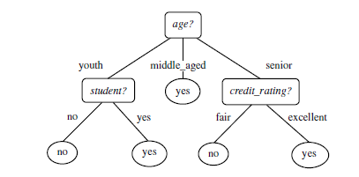
The tree (to be)constructed

Slide 34
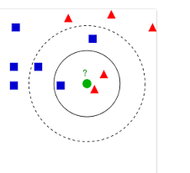
K nearest neighbors
Basic idea:
Define a metric(distance) between two strings. We will get back to it later. For the time being assume that we can define a distance between any two strings.
Ex: Strings “ABCD” and “ADCFG” Distance can be defined as
For all positions, if characters are same, d=0 else 1.
Sum all the ‘d’
Assume there are two types of data points(white sand and red sand) in a set distributed geographically.
Among these, the types of certain points are well known.
How to find out the ‘type’ of unknown points?
The idea used is that the type of a point is type of points which surround the given point at maximum number.
Given a message x, determine its k nearest neighbors among the messages in the training set. If there are more spams among these neighbors, classify given message as spam. Otherwise classify it as legitimate mail

Slide 35
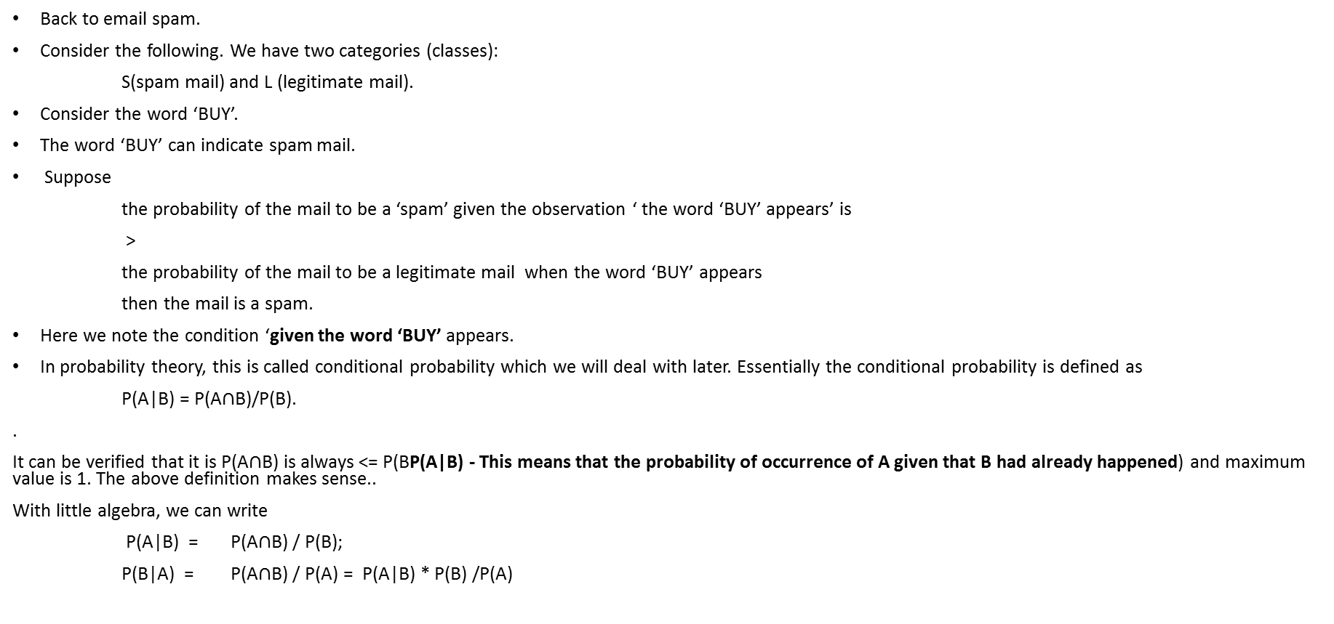
Bayesian – A probabilistic approach
Back to email spam.
Consider the following. We have two categories (classes):
S(spam mail) and L (legitimate mail).
Consider the word ‘BUY’.
The word ‘BUY’ can indicate spam mail.
Suppose
the probability of the mail to be a ‘spam’ given the observation ‘ the word ‘BUY’ appears’ is
>
the probability of the mail to be a legitimate mail when the word ‘BUY’ appears
then the mail is a spam.
Here we note the condition ‘given the word ‘BUY’ appears.
In probability theory, this is called conditional probability which we will deal with later. Essentially the conditional probability is defined as
P(A|B) = P(A$∩$B)/P(B).
.
It can be verified that it is P(A$∩$B) is always <= P(BP(A|B) - This means that the probability of occurrence of A given that B had already happened) and maximum value is 1. The above definition makes sense..
With little algebra, we can write
P(A|B) = P(A$∩$B) / P(B);
P(B|A) = P(A$∩$B) / P(A) = P(A|B) * P(B) /P(A)

Slide 36
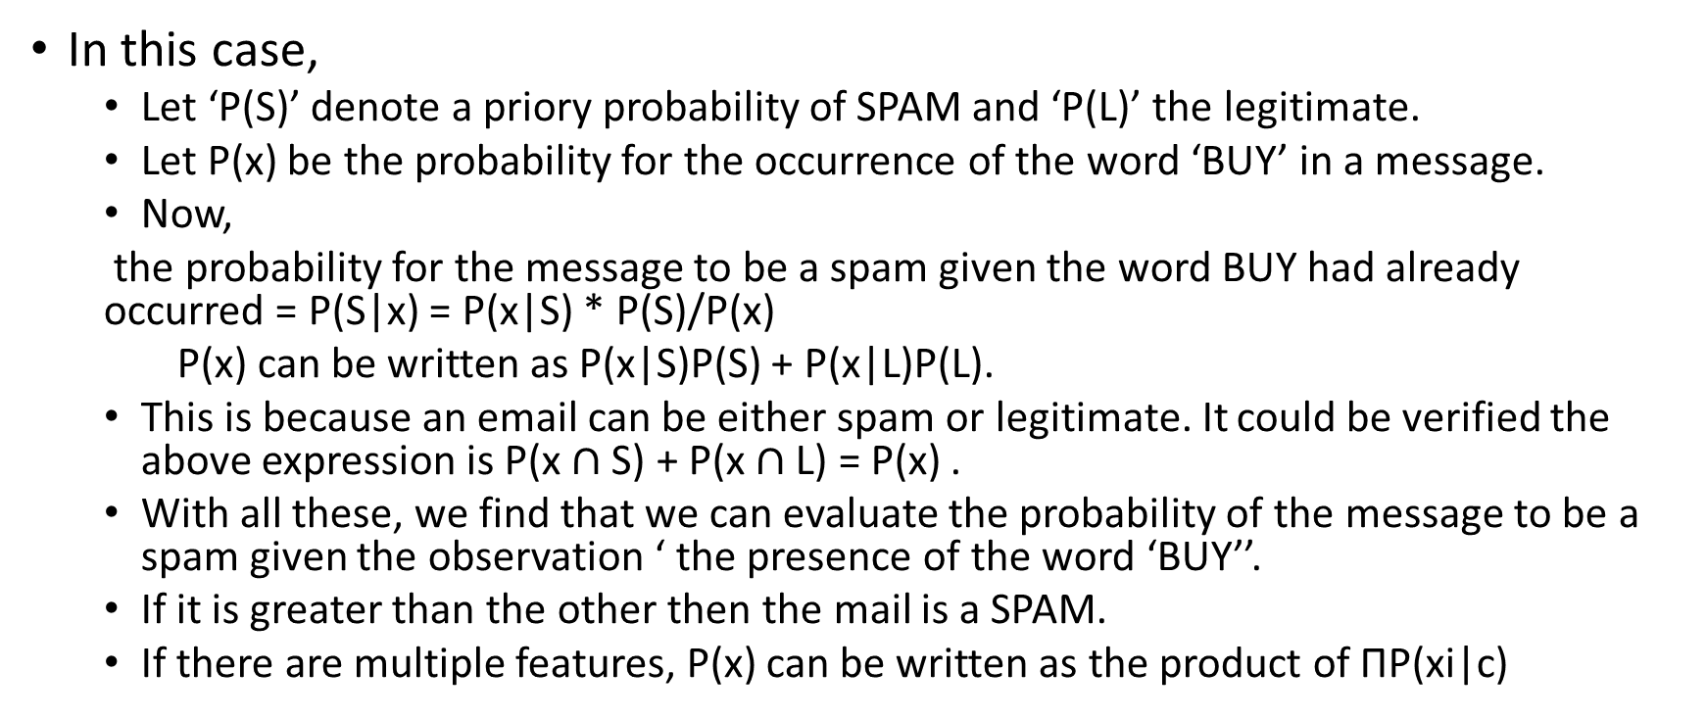
Bayesian cont…..
In this case,
Let ‘P(S)’ denote a priory probability of SPAM and ‘P(L)’ the legitimate.
Let P(x) be the probability for the occurrence of the word ‘BUY’ in a message.
Now,
the probability for the message to be a spam given the word BUY had already occurred = P(S|x) = P(x|S) * P(S)/P(x)
P(x) can be written as P(x|S)P(S) + P(x|L)P(L).
This is because an email can be either spam or legitimate. It could be verified the above expression is P(x $∩$ S) + P(x $∩$ L) = P(x) .
With all these, we find that we can evaluate the probability of the message to be a spam given the observation ‘ the presence of the word ‘BUY’’.
If it is greater than the other then the mail is a SPAM.
If there are multiple features, P(x) can be written as the product of ΠP(xi|c)

Slide 37
Clustering
Clustering belongs to the class ‘Unsupervised learning’ in machine learning In which there is no sample data.
Cluster analysis or simply clustering is the process of partitioning a set of data objects (or observations) into subsets.
Each subset is a cluster, such that objects in a cluster are similar to one another, yet dissimilar to objects in other clusters.
The set of clusters resulting from a cluster analysis can be referred to as a clustering.
The related term is ‘Segmenting’. It is the process of putting customers into groups based on similarities, and clustering is the process of finding similarities in customers so that they can be grouped, and therefore segmented.
Cluster analysis is used in a variety of applications. For example it can be used to identify consumer segments, or competitive sets of products, or groups of assets whose prices co-move, or for geo-demographic segmentation, etc.
In general it is often necessary to split our data into segments and perform any subsequent analysis within each segment in order to develop (potentially more refined) segment-specific insights. This could be done even if there are no natural groups

Slide 38
Clustering can also be used for outlier detection, where outliers (values that are “far away” from any cluster) may be more interesting than common cases.
Applications of outlier detection include the detection of credit card fraud and the monitoring of criminal activities in electronic commerce.

Slide 39
Frequent item sets, Market basket,….
In Amazon.com, we could have seen statements like people who have bought …… have also bought ……..
This information is not just message to the customers but also help in planning and organization of goods in the shops.
A laptop buyer can be expected to buy the accessories like mouse and also the bag.
To identify such ‘groups’ from sales data, there is a need for systematic procedures.

Slide 40
Example
Frequent itemset mining leads to the discovery of associations and correlations among items in large transactional or relational data sets.
With massive amounts of data continuously being collected and stored, many industries are becoming interested in mining such patterns from their databases.
The discovery of interesting correlation relationships among huge amounts of business transaction records can help in many business decision-making processes such as catalog design, cross-marketing, and customer shopping behavior analysis.
A typical example of frequent itemset mining is market basket analysis. This process analyzes customer buying habits by finding associations between the different items that customers place in their “shopping baskets” (

Slide 41
Market basket ideas
If we think of the universe as the set of items available at the store, then each item has a Boolean variable representing the presence or absence of that item.
Each basket can then be represented by a Boolean vector of values assigned to these variables.
These patterns can be represented in the form of association rules.
For example, the information that customers who purchase computers also tend to buy antivirus software at the same time is represented in the following association rule:
Computer => antivirus software [support D 2%,confidence D 60%]. (6.1)
Rule support and confidence are two measures of rule interestingness. They respectively reflect the usefulness and certainty of discovered rules.
Typically, association rules are considered interesting if they satisfy both a minimum support threshold and a minimum confidence threshold. These thresholds can be a set by users or domain experts.

Slide 42
R – the statistical language and machine learning
It is an open-source dialect of the S statistical computing language.
It is free, runs on most computing platforms, and contains contributions from top computational statisticians.
The basic R system is developed and maintained by the R Core group, comprising 20 members, many of them eminent in the field of statistical computing.
The R Project for Statistical Computing is a project of the R Foundation, whose membership includes the R Core group and several other individuals, and is also associated with the Free Software Foundation.

Slide 43
There are more than 5000 freely available “packages” of documented R programs and data to CRAN (the Comprehensive R Archive Network) http://cran.rproject.org/web/packages/index.html.
As well, R is especially capable in the area of statistical graphics, reflecting the origin of S at Bell Labs, a center of graphical innovation.
Reference:
http://www.icpsr.umich.edu/summerprog/biblio/2014/Introduction%20to%20the%20R%20Statistical%20Computing%20Environment.pdf
The standard reference
https://cran.r-project.org/doc/manuals/R-intro.pdf
Download R for windows version 3.4.2.
https://cran.r-project.org/bin/windows/base/

Slide 44
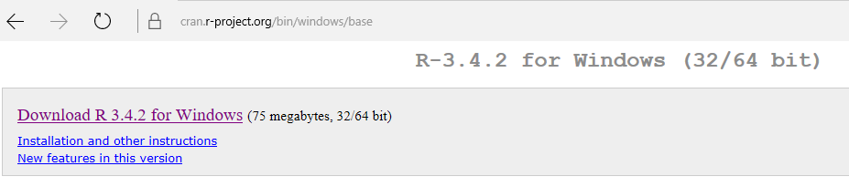
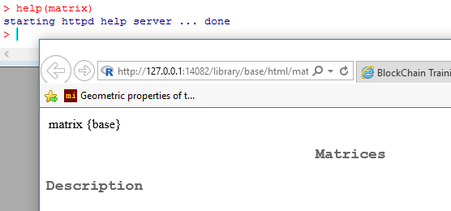
The R cheat sheet contains all the important features of R. The cheat sheet contains all the important basic features of R.
https://www.rstudio.com/wp-content/uploads/2016/10/r-cheat-sheet-3.pdf ( 2 sheets)

Slide 45
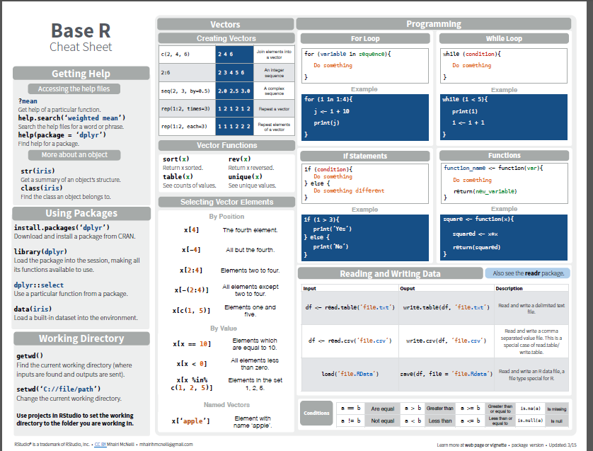

Slide 46
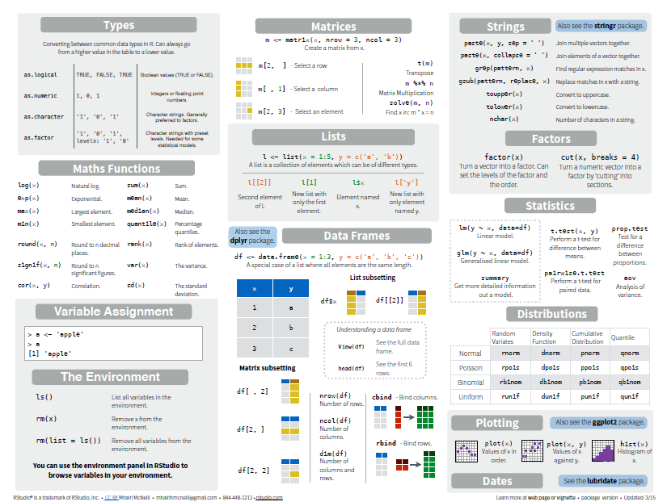

Slide 47
Special Values in R
NA – ‘not available’, usually a default placeholder for missing values.
NAN – ‘not a number’, only applying to numeric vectors.
NULL – ‘empty’ value or set. Often returned by expressions where the value is undefined.
Inf – value for ‘infinity’ and only applies to numeric vectors.

Slide 48
A few commands to start with
getwd() prints the working directory
setwd(“C:/siva/Rprograms”) moves the working space to the directory given.
Ex: > getwd()
[1] "C:/Users/263749/Documents“
> setwd("c:/siva")
> getwd()
[1] "c:/siva”
“\\” sometimes work in place of forward ‘/’.
There are many packages that are to be loaded for various functionalities.
They are available in a website called ‘CRAN’.
From the command prompt those packages can be downloaded and installed.
The command is as follows.
install.packages(“lpsolve”) # where ‘lpsolve’ is the package for solution of linear equations.
Library(lpsolve);

Slide 49
# List files in directory:
list.files()
Viewing initial and tail portion of any file
head(<file_name>)
Tail(<file_name>)
View number of rows and column, or alternatively, the dimension of the dataset
nrows(<dataset>)
ncol(<dataset>)

Slide 50
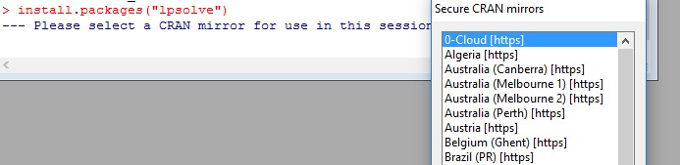
Package loading
It errored out as is should be typed as ‘lpSolve’.
On selection of the mirror, it downloads and installs the package.
> install.packages("lpSolve")
trying URL 'https://cran.revolutionanalytics.com/bin/windows/contrib/3.4/lpSolve_5.6.13.zip'
Content type 'application/zip' length 733314 bytes (716 KB)
downloaded 716 KB
package ‘lpSolve’ successfully unpacked and MD5 sums checked
The downloaded binary packages are in
C:\Users\263749\AppData\Local\Temp\RtmpqYKfDT\downloaded_packages
This should be followed by the command to include it in the library.
>library(“lpSolve”)

Slide 51
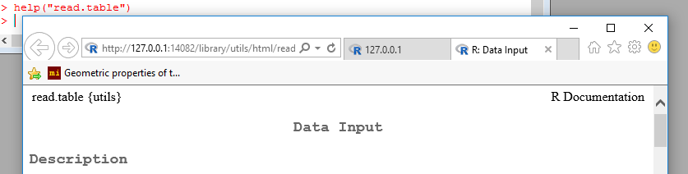
Exercise:
Install a package “ggplot2” and get the help file opened.
Reading and writing data:
Basic commands can be had from cheat sheet or Google.
The documentation can be had from CRAN website as follows.
The first requirement is to read the data from the files in a system.

Slide 52
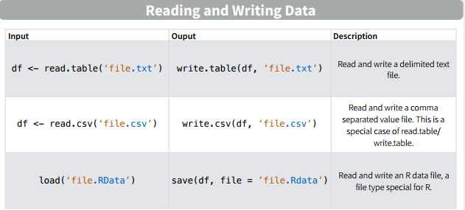
Read and write (Please practice)

Slide 53
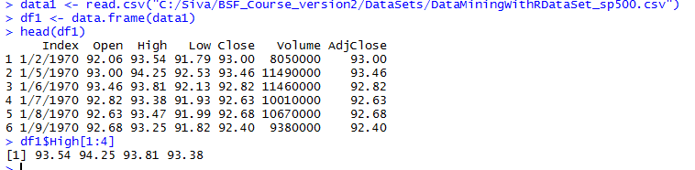
Reading csv file and data frame generation and subsetting(To be detailed later)

Slide 54
Data frame
A data frame is a list with class "data.frame".
There are restrictions on lists that may be made into data frames, namely
The components must be vectors (numeric, character, or logical), factors, numeric matrices, lists, or other data frames.
Vector structures appearing as variables of the data frame must all have the same length, and matrix structures must all have the same row size.
A data frame may for many purposes be regarded as a matrix with columns possibly of differing modes and attributes. It may be displayed in matrix form, and its rows and columns extracted using matrix indexing conventions.
The data frame function helps to name each column and row of the data elements.

Slide 55
Data frames
a <- read.table("C:/Siva/data_sets/freeny_rev_data.csv", sep=',',header = TRUE)
> head(a)
x y lag.quarterly.revenue price.index income.level market.potential
1 1962.25 8.79236 8.79636 4.70997 5.82110 12.9699
2 1962.50 8.79137 8.79236 4.70217 5.82558 12.9733
3 1962.75 8.81486 8.79137 4.68944 5.83112 12.9774
4 1963.00 8.81301 8.81486 4.68558 5.84046 12.9806
5 1963.25 8.90751 8.81301 4.64019 5.85036 12.9831
6 1963.50 8.93673 8.90751 4.62553 5.86464 12.9854
> b <- data.frame(a)
> b$x[1]
[1] 1962.25
> b$lag.quarterly.revenue[1]
[1] 8.79636

Slide 56
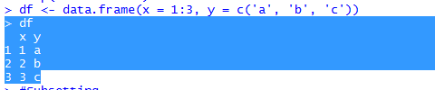

Data frame: Basic applications
Data frame with different types of data
df <- data.frame(x = 1:3, y = c('a', 'b', 'c'))
The following command illustrates the selection command

Slide 57
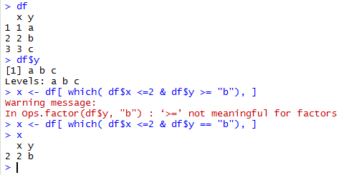
Selection or sub setting

Slide 58

Subset command

Slide 59

Vectors and matrices
R operates on named data structures. The simplest such structure is the numeric vector, which is a single entity consisting of an ordered collection of numbers.
Assignment - defining a vector
x <- c(10.4, 5.6, 3.1, 6.4, 21.7)
Algebra can be performed among vectors

Slide 60

Functions of a vector
Mean(x) gives the mean value of the elements in x vector.
Good example function is
sum((x-mean(x))^2)/(length(x)-1) which is nothing but variance.

Slide 61
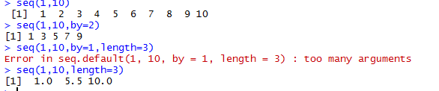

Generating sequences
Logical vectors by conditions

Slide 62
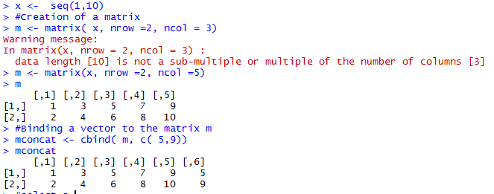
Same way rows can be attached.

Slide 63
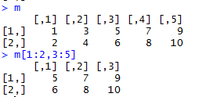
Extraction from matrix

Slide 64
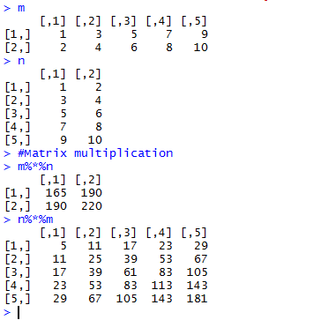
Matrix multiplication

Slide 65
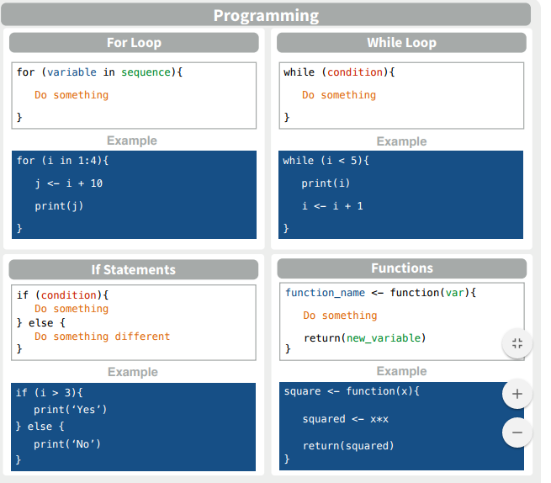
Programming

Slide 66
SQL queries in R using data.frame
install.packages(“sqldf”)
library(sqldf)
An example command
sqldf("select * from a where x = 1962.75")
x y lag.quarterly.revenue price.index income.level market.potential
1 1962.75 8.81486 8.79137 4.68944 5.83112 12.9774

